Slide 1



Team | Introduction
Content:
What have we built?
How have we built?
Impact of MedvAIsor tool.

Slide 2
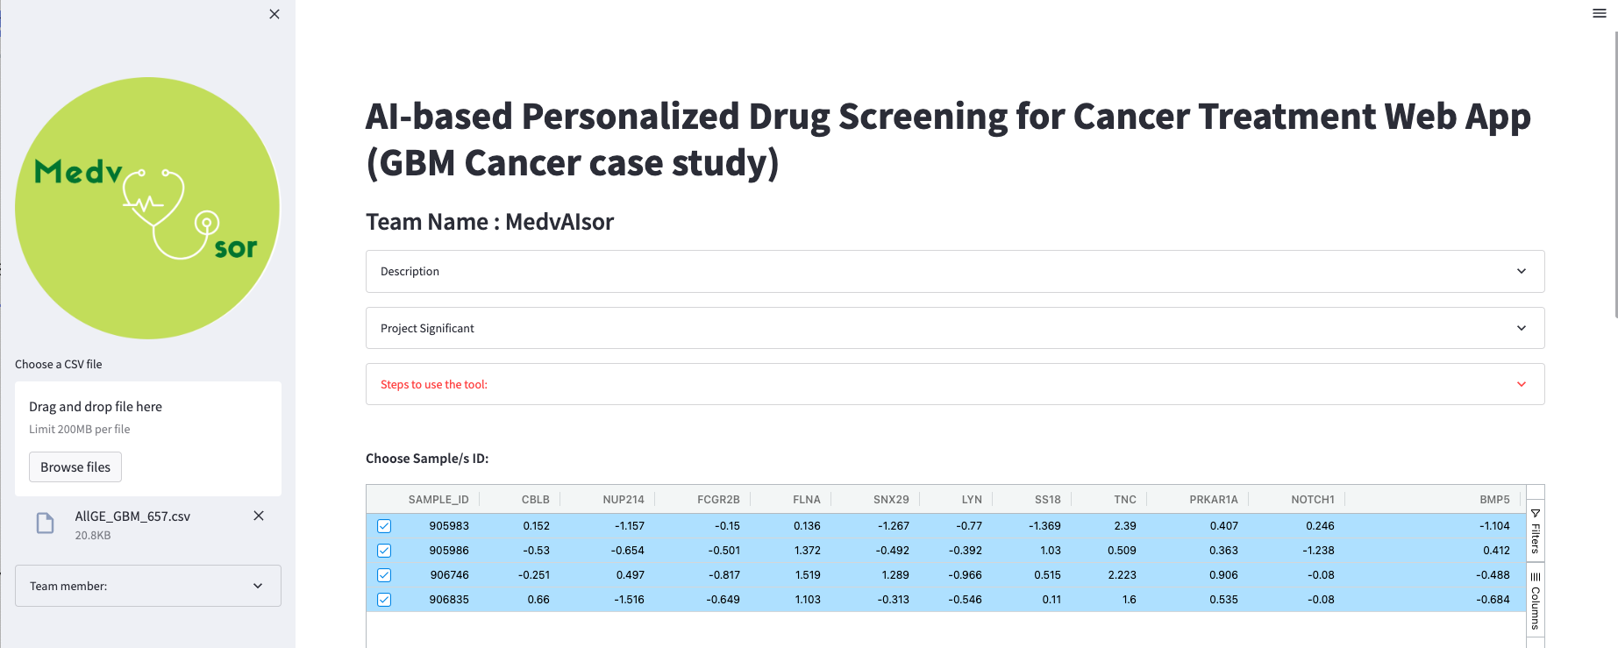
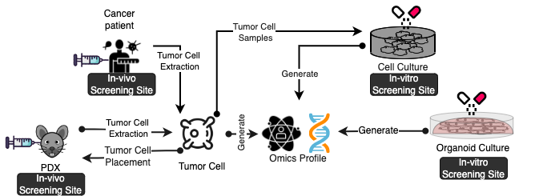
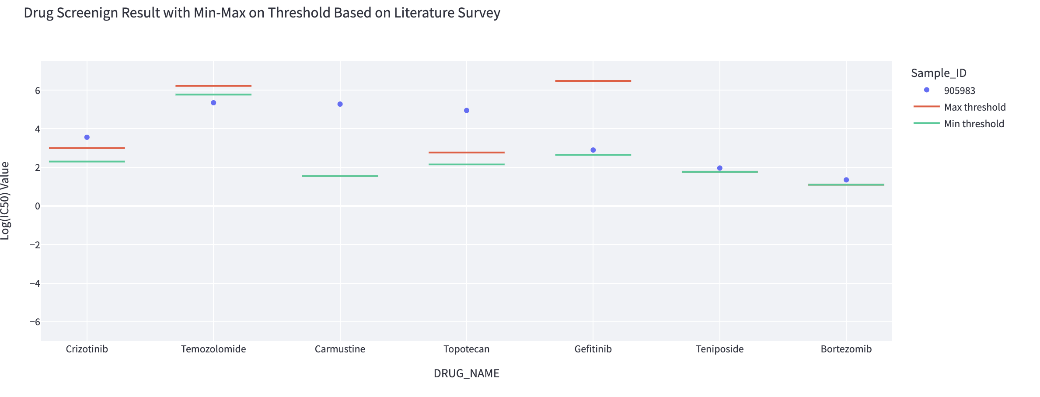
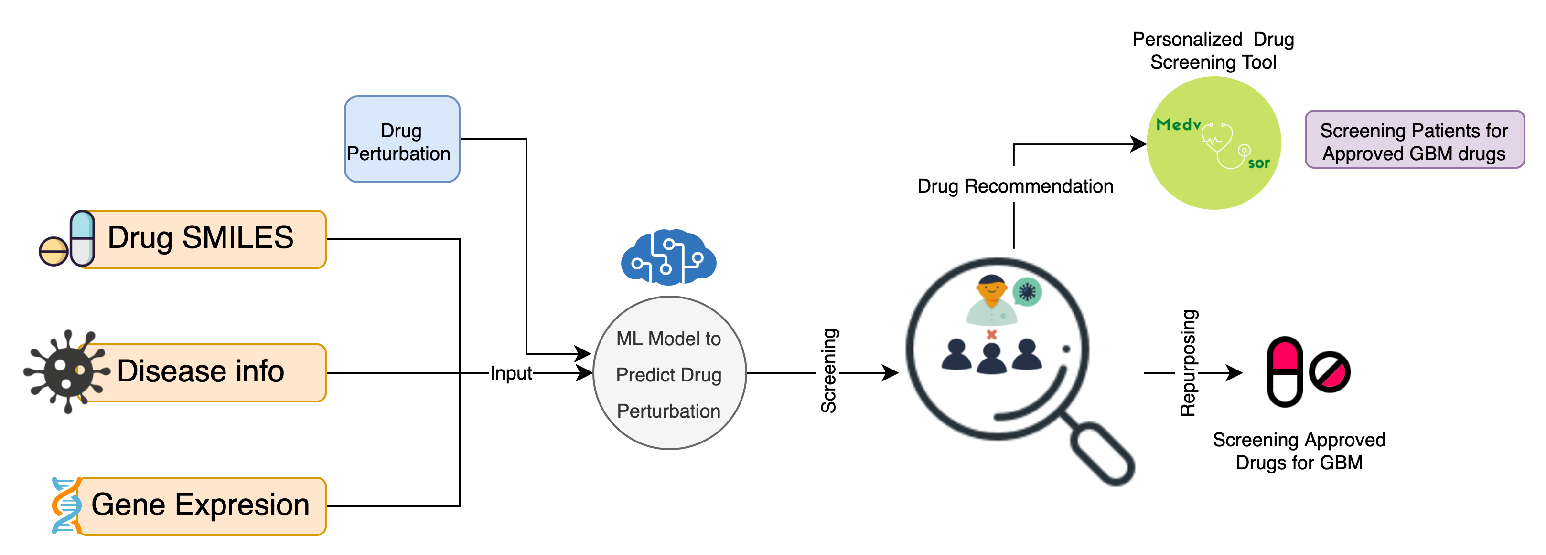
Motivation | S/w Created
Drawback of In-vivo & In-vitro
In-vivo
1- Expensive
2- Time Consuming
3- Strictly Regulated
In-vitro
1- Relatively less expensive 2- Relatively less time consuming 3- Less regulated and has more control over experiments
In-silico is a viable option
A web Application
Thresholds for screening
 | Literature-based Threshold |  | GDSC-based Threshold
GBM-drugs | Min | Max | Min | Max
Bortezomib | 2.30 | 3.00 | -5.55 | -5.16
Carmustine | 5.77 | 6.22 | 5.51 | 6.20
Crizotinib | 1.55 | 1.55 | 3.37 | 3.67
Gefitinib | 2.15 | 2.77 | 3.35 | 3.79
Temozolomide | 2.65 | 6.48 | 5.68 | 6.54
Teniposide | 1.77 | 1.77 | 0.01 | 0.81
Topotecan | 1.10 | 1.10 | -0.88 | 0.25
Recommendations are based on predictive modeling.
What have we built?

Slide 3

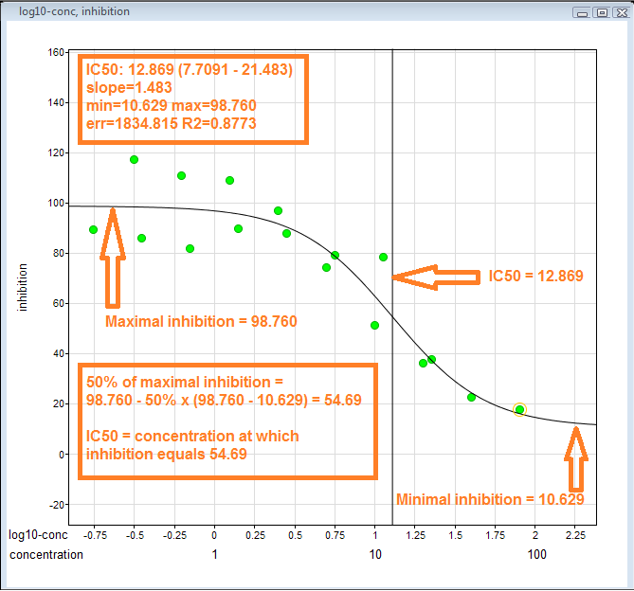

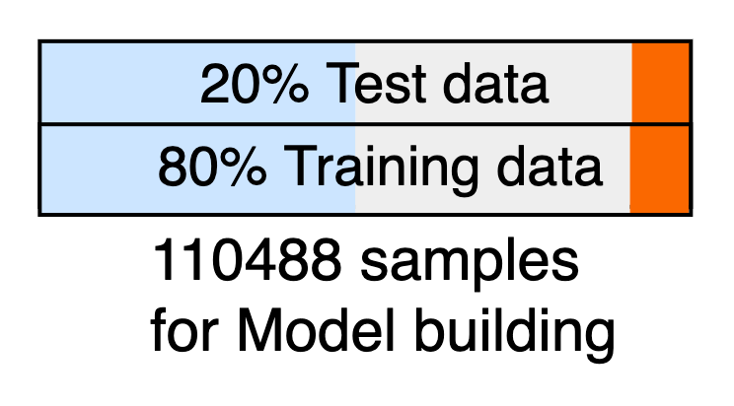

Data | Methodology | Results
One hot Coding of 31 Cancer types
BRCA | KIRC | GBM | ……. | PRAD
1 | 0 | 0 | 0…..0 | 0
0 | 1 | 0 | 0…..0 | 0
0 | 0 | 1 | 0…..0 | 0
. | . | . | 1…..0 | .
0 | 0 | 0 | 0…..0 | 1
657 Genes based on Cancer Gene Census, obtained From COSMIC database
The model was built with 80% Pan-cancer data, with 10-fold cross-validation.
How have we built?

Slide 4
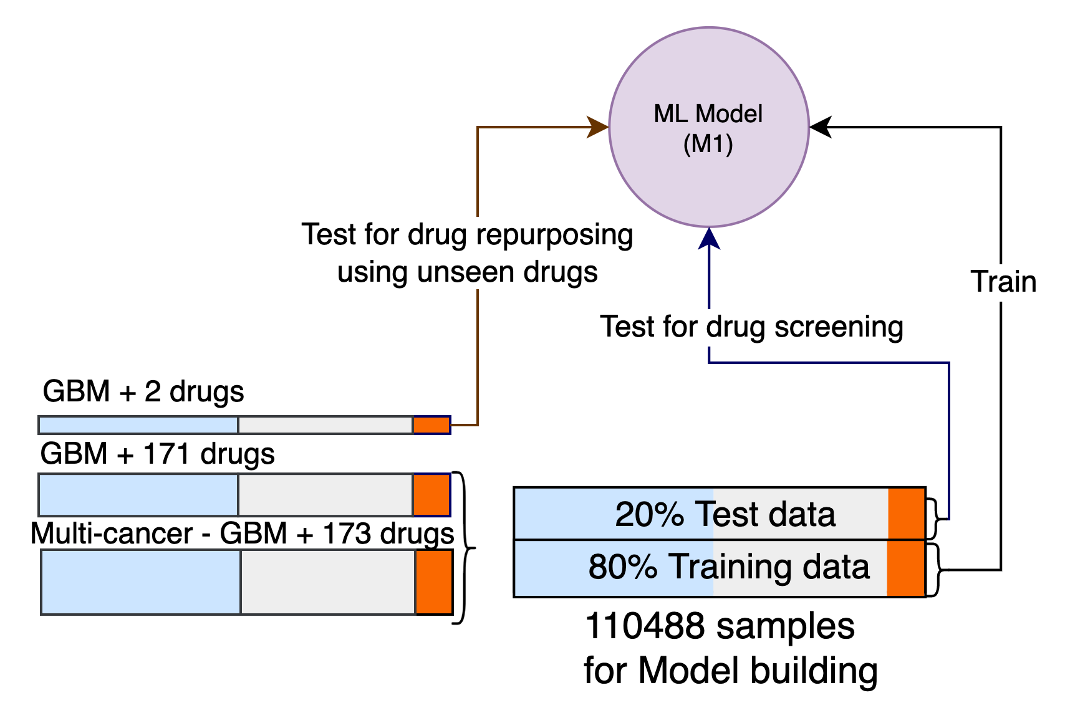
Data | Methodology | Results
Result of Test data
 | MAE | MSE | RMSE | R2 | RMSLE | MAPE
Test data | 0.77 | 1.0 | 1.0 | 0.85 | 0.28 | 1.31
Drug Screening Experiment
Drug Repurposing Experiment
Drug Name | MAE | MSE | RMSE | R2 | RMSLE | MAPE
Carmustine | 0.53 | 0.41 | 0.64 | 0.55 | 0.09 | 0.09
Temozolomide | 0.45 | 0.32 | 0.57 | 0.64 | 0.08 | 0.08
Result for Repurposing
How have we built?

Slide 5
Innovation | Impact
Drug recommendation for individualized treatment
Individualized Drug Repurposing
Thank you…..
Sample GE
Demo
Impact of MedvAIsor

